Slide 1
Real-time ML Journey
MicrosoftML + Revoscale
Hiram Fleitas
Senior Customer Engineer
Microsoft Data & AI
aka.ms/hiram, badges
Notes:
Make this an advisory package about ML/AI/Ops. Industry specific. Invite levels of leaderships. Cs. 1-2hr session.

Slide 2
About Me
Machine Learning
Synapse Analytics
Power Platform
DevOps
aka.ms/hiram

Slide 3



















1995
1999
2000s
2017
2021
Legal, Medical, Retail, Travel Insurance, ISV, HR, Cruise Line, PnC Insurance, plus more…

Slide 4














2017
2018
2019
2020
2021

Slide 5
Agenda
Sentiment
QnA Chat Bots
Forms
Capital Modeling
Length of Stay
Search by Photo
$30M
$200K
$2M
$500M
$40M
$200K
with impact

Slide 6
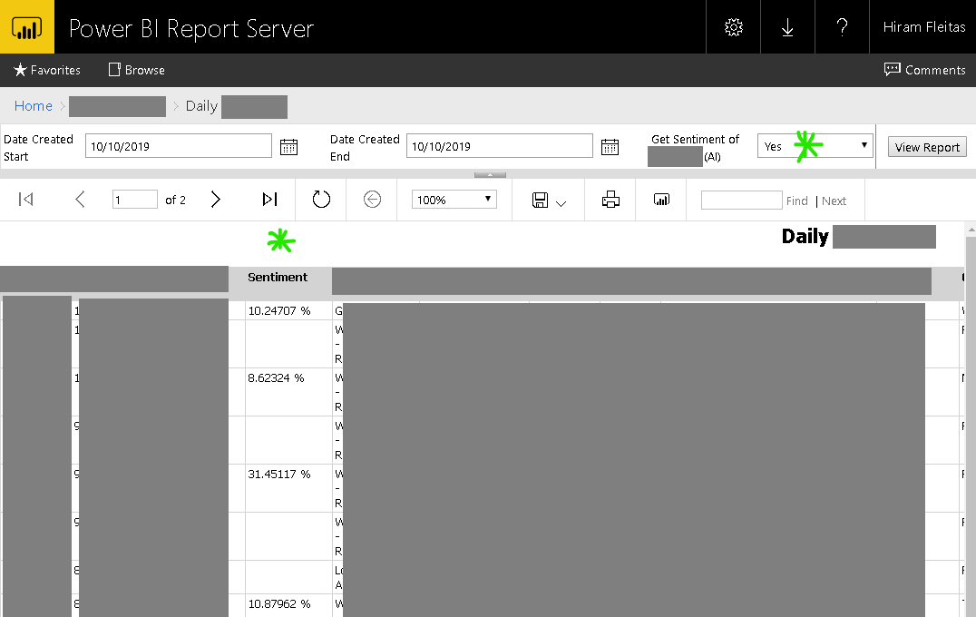
Learn more:
Hide Column based up Parameter Selected SSRS
Notes:
Script to share scenerios of ML used at some companies.

Slide 7
create or alter proc GetCognitiveAPIQuoteSentiment
as
set nocount on;
declare @py nvarchar(max);
set @py = N'import requests, pprint as pr
from pandas.io.json import json_normalize
apikey = "mykey"
api = "https://eastus2.api.cognitive.microsoft.com/text/analytics/v2.0/"
url = api + "sentiment"
df = jsondocs
headers = {
"Ocp-Apim-Subscription-Key": apikey,
"content-type": "application/json"
}
response = requests.post(
url,
headers = headers,
data = df.iloc[0][0].encode()
)
rds = response.json()
df2 = json_normalize(rds, "documents")
pr.pprint(rds)
print(type(df2),df2,sep="\n")
';
drop table if exists apiresults;
create table apiresults (id int, score float);
insert into apiresults
exec sp_execute_external_script @language = N'Python'
,@script = @py
,@input_data_1 = N'select * from JsonQuotes'
,@input_data_1_name = N'jsondocs'
,@output_data_1_name = N'df2'
select * from apiresults;
update q
set q.Sentiment = a.Score
from Quotes q
inner join apiresults a
on q.quoteid = a.id
where q.Sentiment is null;
go
Learn more:
github.com/hfleitas/seattle2019/blob/master/2SentimentPrediction/Trollhunters.ipynb

Slide 8
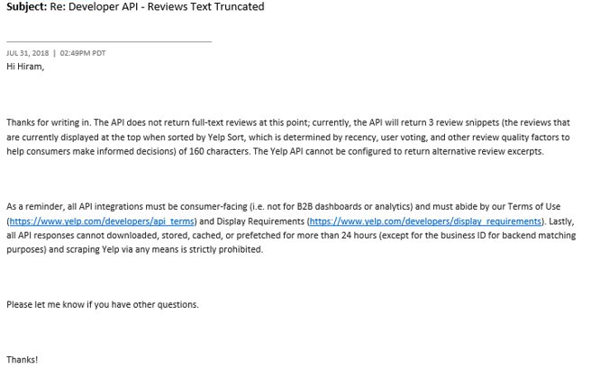
Learn more:
https://www.yelp.com/developers/api_terms
https://www.yelp.com/developers/display_requirements

Slide 9
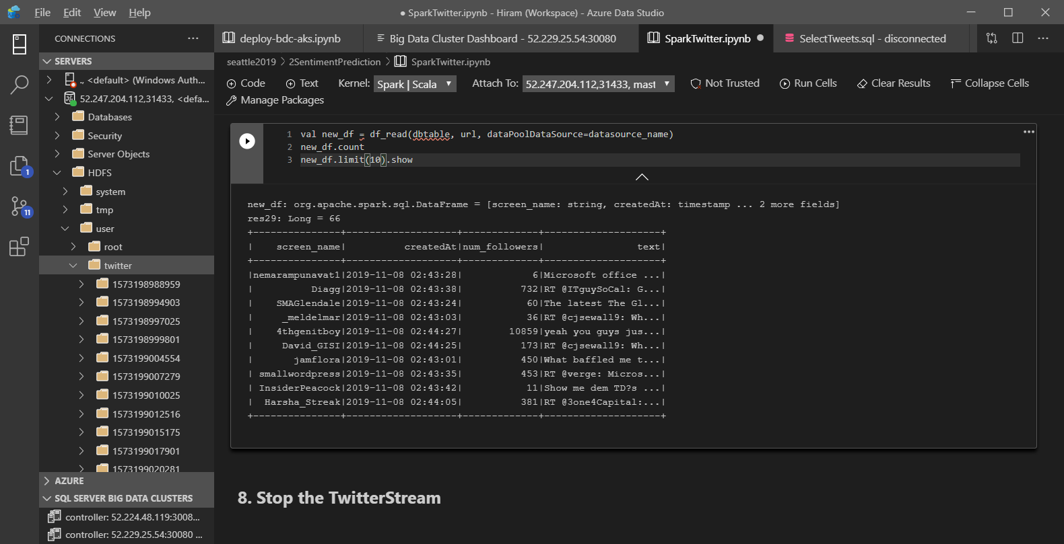
Learn more:
SQL Server Samples - Big Data Clusters - Spark

Slide 10
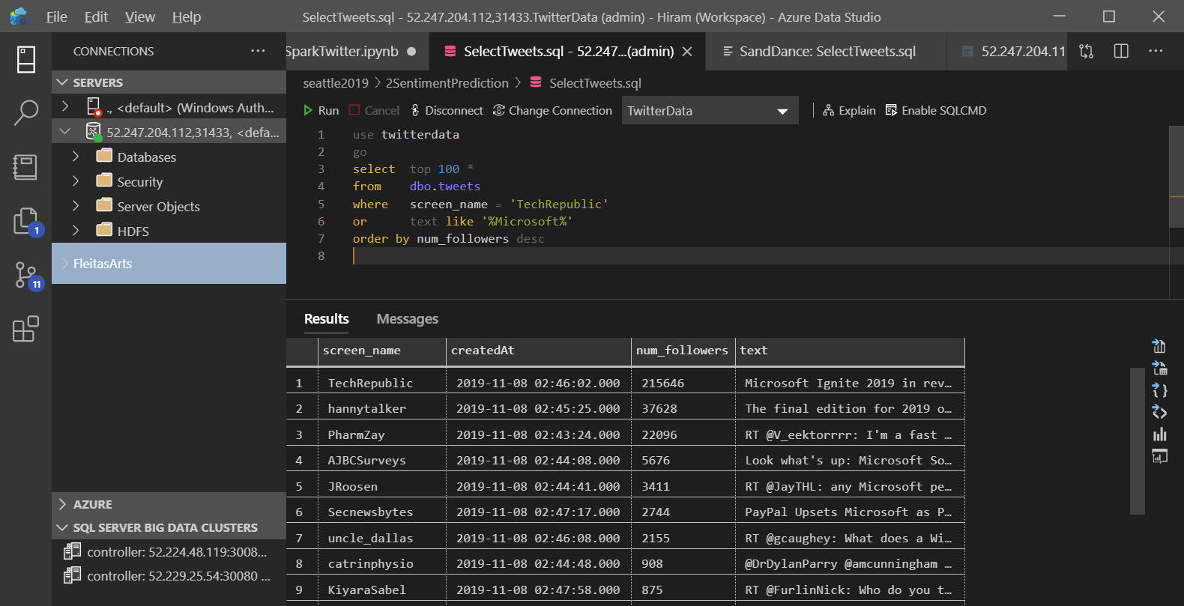
Learn more:
SQL Server Samples - Big Data Clusters - Spark

Slide 11
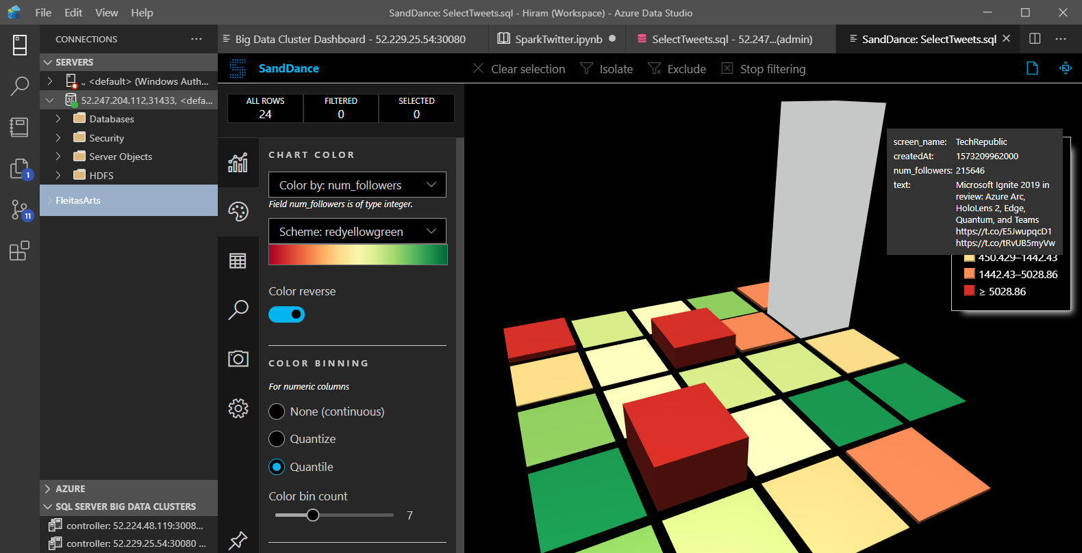
Learn more:
SQL Server Samples - Big Data Clusters - Spark

Slide 12
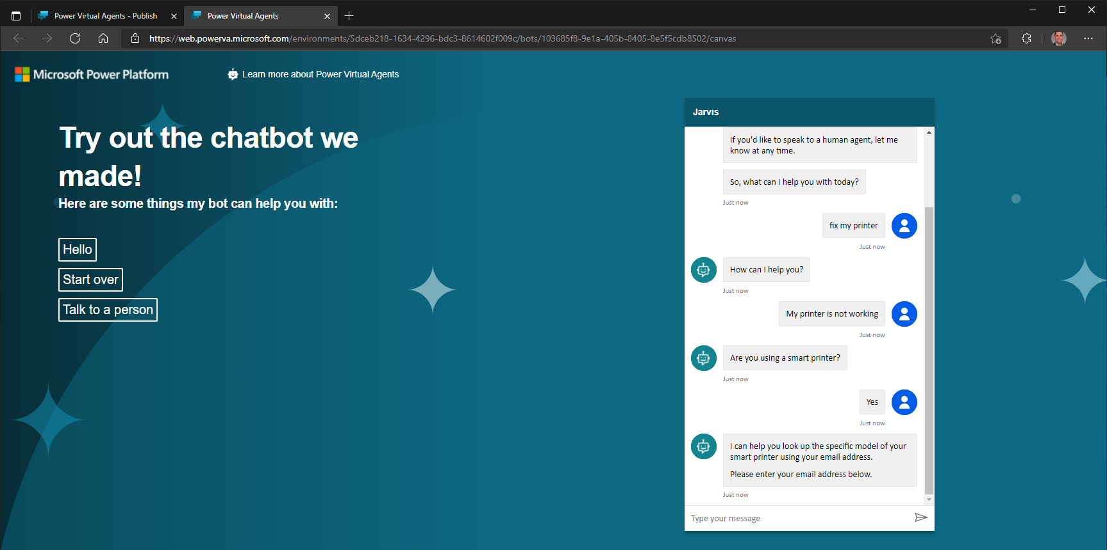
Learn more:
Hide Column based up Parameter Selected SSRS
Notes:
Helps towards training – onboarding.

Slide 13
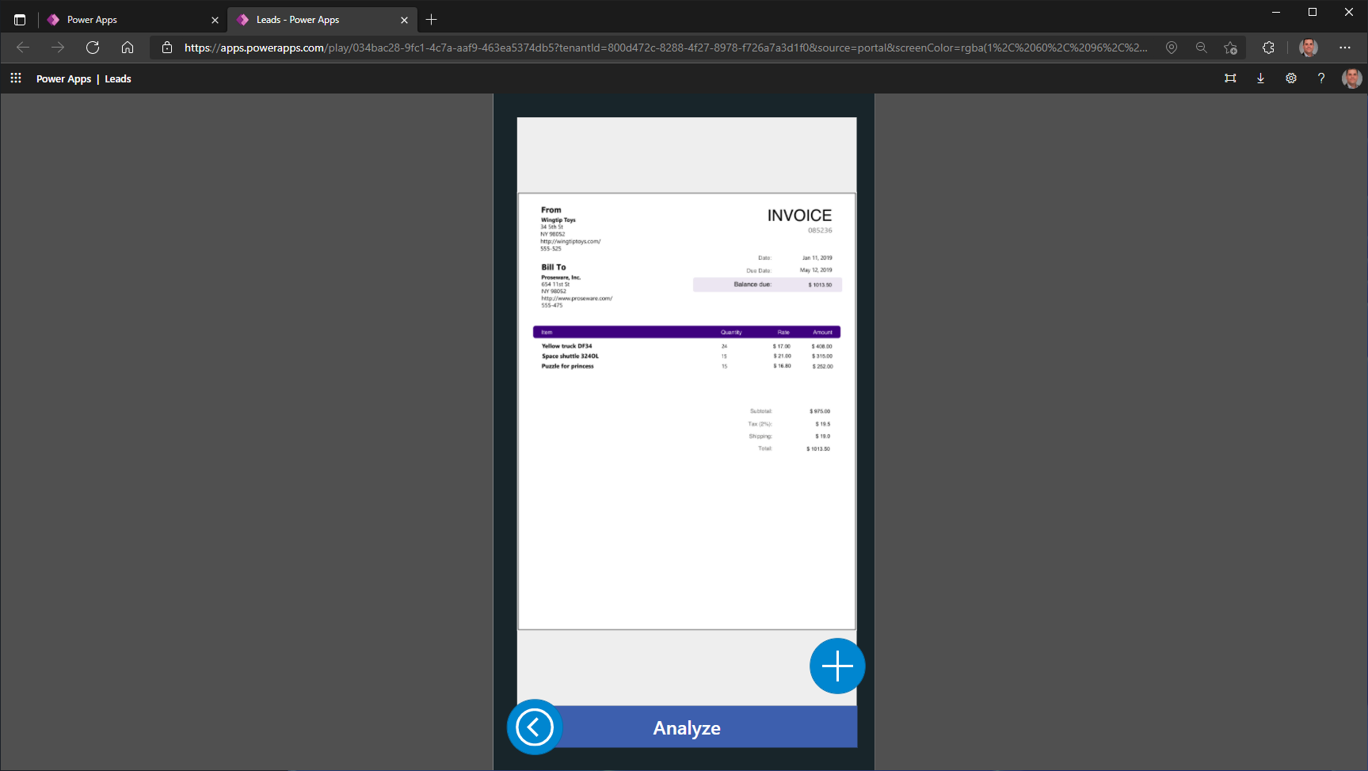

Slide 14
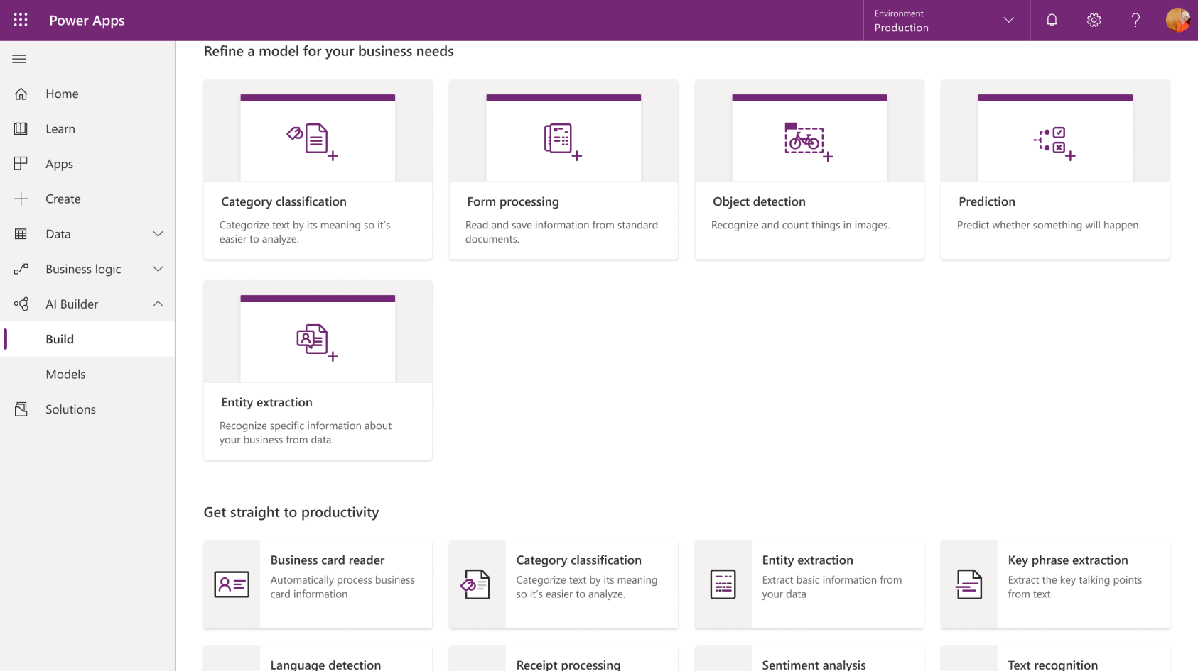

Slide 15
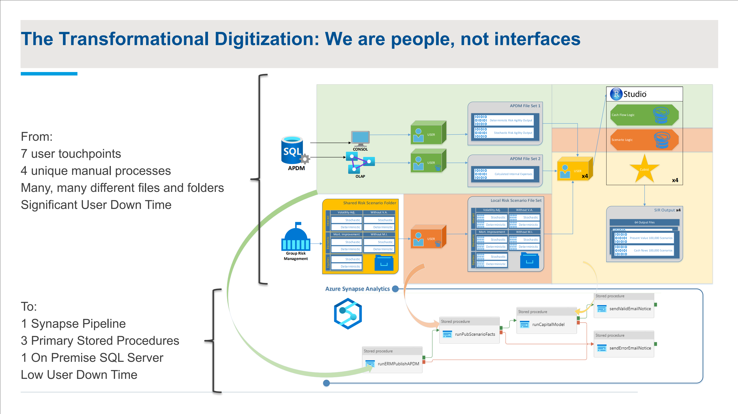
Notes:
Animate synapse portion activities – keep it organic. Give this slide X minutes to stick to flow. 15 minutes max for walking deck. CSAM – leverage the team, not just Hiram. Schedule 30min call with Neelie and Matt, how it resonated with her.
Show them how to start this journey. If they wanna take this step, where do they start.

Slide 16
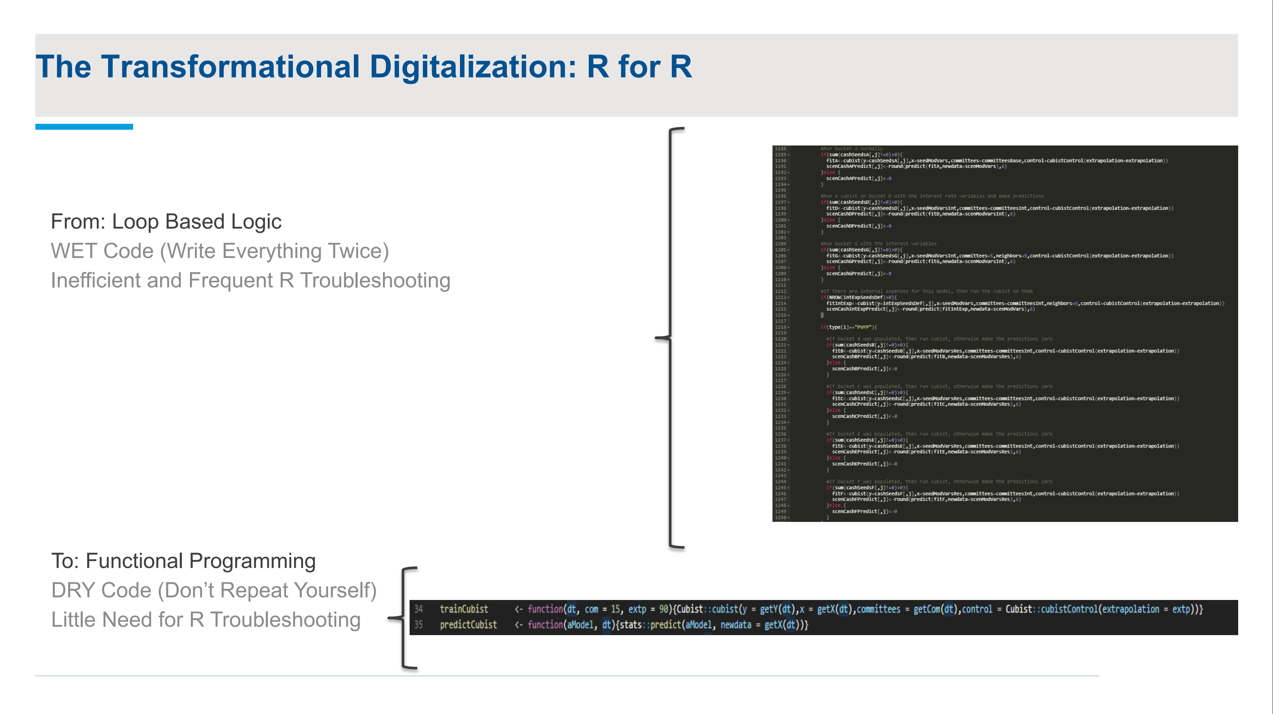

Slide 17
How to get started? How to reproduce?
Identify similar manual data pulls and user transformations that tie to high-financial business value (ROI).
Optimize (simplify) by unifying some workloads (leveraging modern cloud technologies).
Find common data views (knowledge) that will help democratized understanding.
Get motivated because down-stream consumers/users will ask for better/sooner results.
Find someone with drive and systematic thinking.
aka.ms/mlsqldev, aka.ms/adf/azurelearn
RStudio Cheatsheets - RStudio

Slide 18
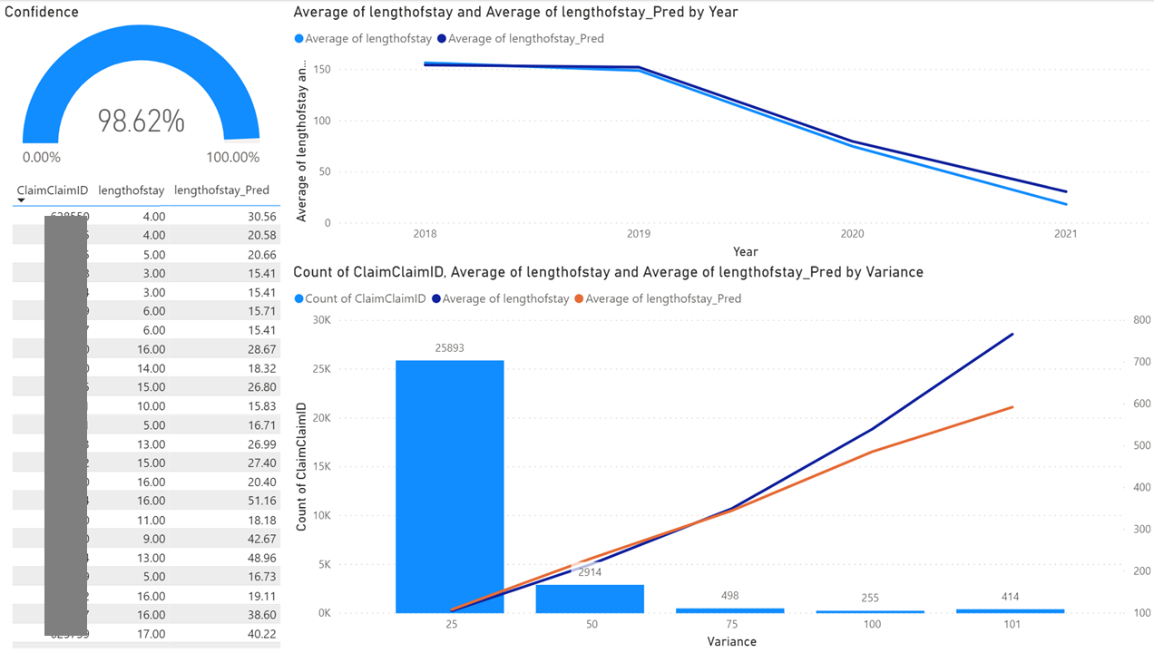

Slide 19
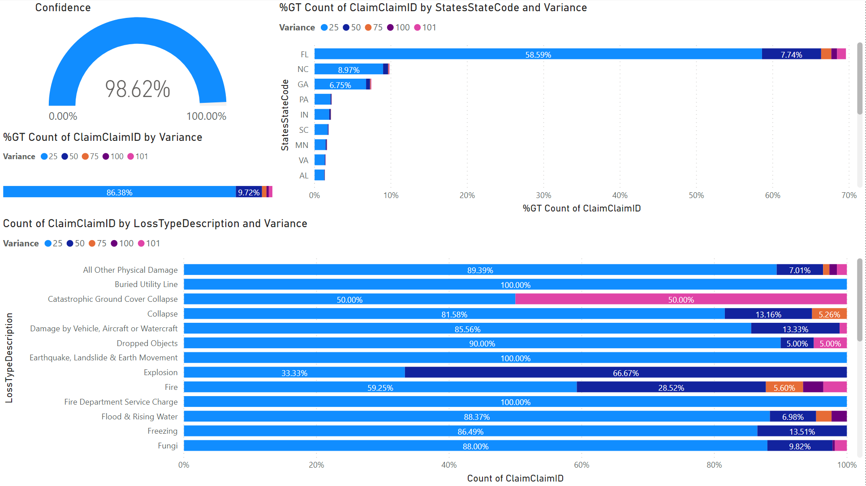
Notes:
1. Target the DS audience on splitting data. Value add leveraging Cog Services tools. Feature engineering - data science.

Slide 20
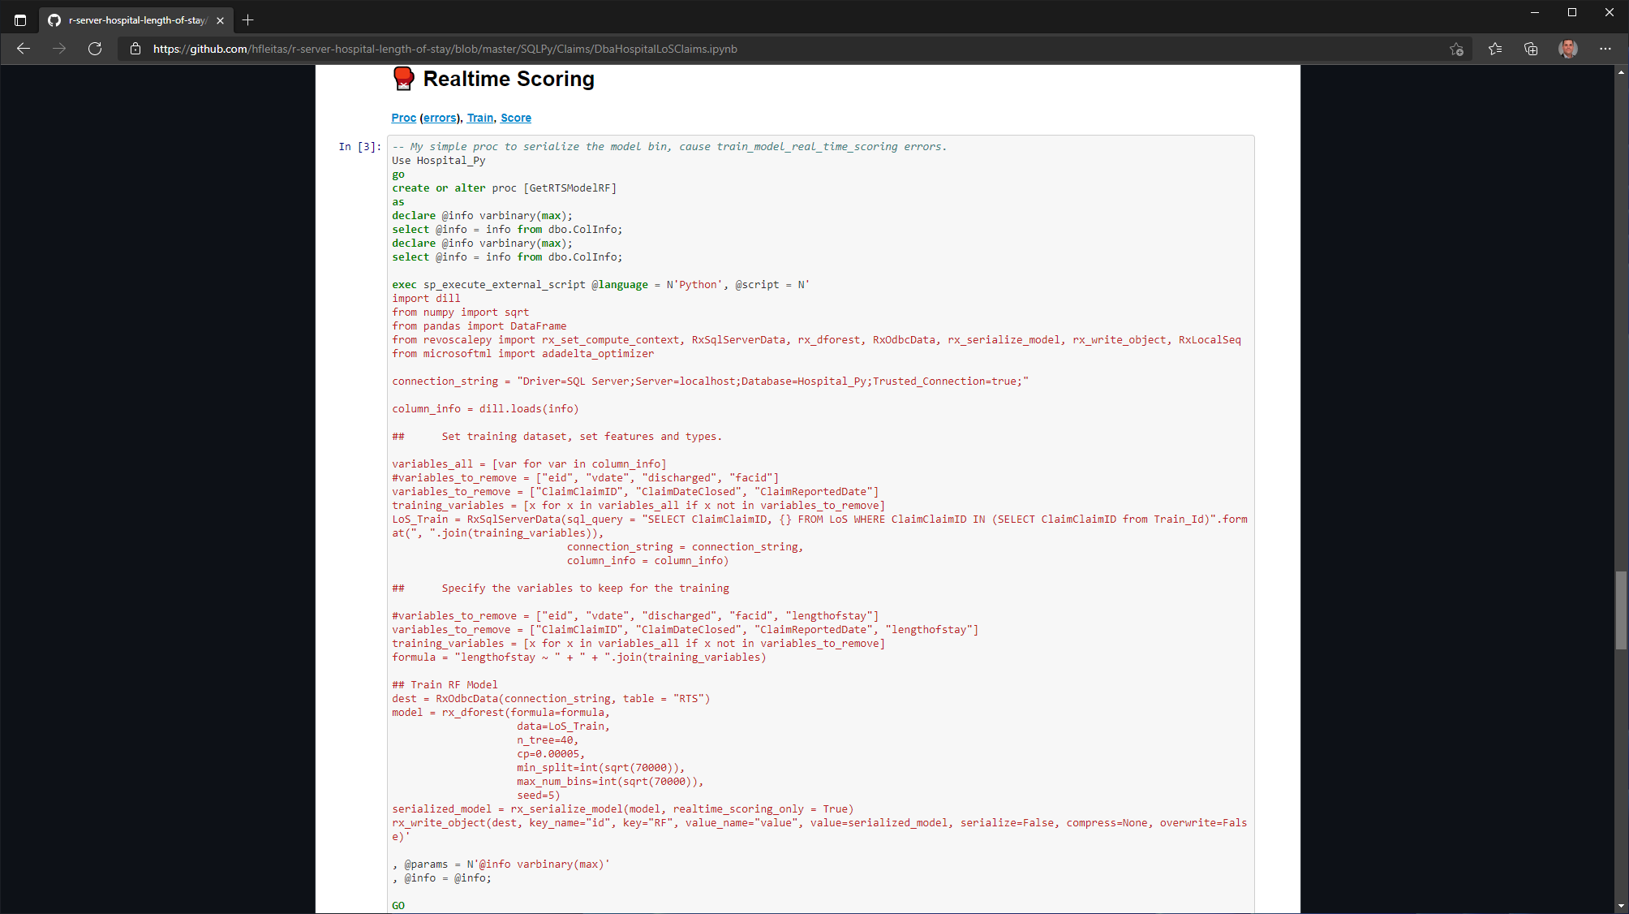


Slide 21
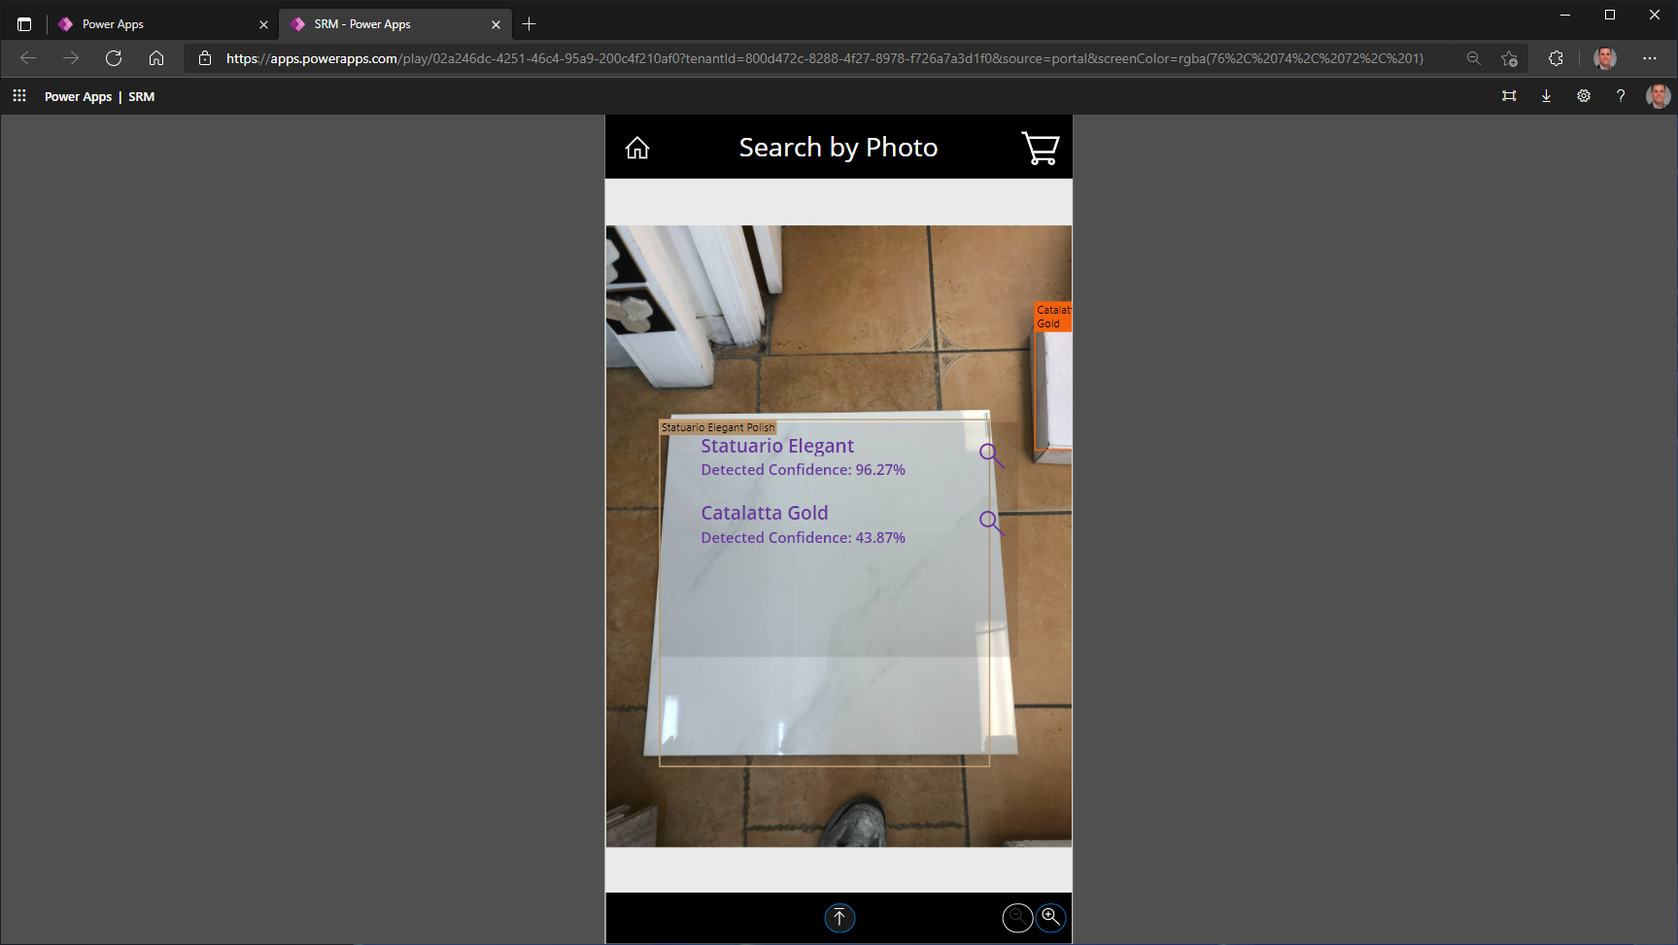

Slide 22
Repo 1 (SQL, Python, JS on Node, Power BI) :
https://github.com/hfleitas/r-server-hospital-length-of-stay/blob/master/SQLPy/Claims/DbaHospitalLoSClaims.ipynb
Video (3 minutes) :
https://youtube.com/watch?v=NGbk9XGWTHI&t=3163s
Repo 2 (SQL BDC, Spark/Scala, Python, Azure Cog API, Paginated Reports) :
https://github.com/hfleitas/seattle2019/blob/master/2SentimentPrediction/%5BDev%5D_HiramFleitas_RealtimeSentimentPredictionSQLServer.pdf

Slide 23
Feedback Snippets
CSAM
Invaluable assistance.
The right skills at the right time.
Improved remarkably in one working session with Hiram.
CSAM APDM
Incredible expertise
Flexible in going in different directions
Good balance of customer obsession
Operates under the One Microsoft mantra
S500 Customer
Helped us successfully solution, setup, configure
he was able to get us running in less than a week.
HUGE Millstone.
Helped us deliver almost real time reporting
S500 Customer
We could not have completed this without Hiram
His work and dedication to the project was excellent
CSAM
He’s been our best from the Data and AI space.
Recently won an Azure compete over AWS for Inventory Management and Predictive Maintenance.

Slide 24
Thank you
Hiram Fleitas
aka.ms/hiram, badges

